Slide 1
Call1800.org

Slide 2
Theme use
http://wrapbootstrap.com/preview/WB0L7L747 ( use this modern UI )
http://wrapbootstrap.com/preview/WB0227870 ( it has good UX)
Copy content from
https://www.tollfreeproxy.com/#faq
The Toll Free number search should copy from http://inter800.com/ using our own UI

Slide 3
US/Canada 1800 search your area
International 1800 search all over the world
Register your 1800 let customers find you

Slide 4
Call1800.org
Call
Enter Number to Call
http://call1800.org/1800xxxxxxx
Search Toll Free Number
< Search Term >
Call
Company Name | Number
Call
Call
FREE WebRTC Click2Call API
http://call1800.org/<Your Toll Free Number>
FREE WebRTC Click2Call Popup
<javascript>
http://call1800.org/<Your Toll Free Number>
</javascript>

Slide 5
Get Your Number
1800, 1888, 1866,1877,1855,1844
Pattern
Pay Per Minute
Number | Monthly Fee | Per Minute Fee
 | 1 | 0.015
 | 1 | 0.015
 | 1 | 0.015
 | 1 | 0.015
 | 1 | 0.015
Buy
Monthly Plan
Buy
Monthly Plan
Buy
Monthly Plan
Buy
Monthly Plan
100 % Completion Rate
Never Worry your client can’t find you
Pay Per Usage
You don’t lose on monthly fee.

Slide 6
1-800-xxx-xxxx
You Selected
Plan | Monthly Fee | Per Minute Fee
500 Min | 1 | 50 USD
1000 Min | 1 | 100 USD
2000 Min | 1 | 200 USD
5000 Min | 1 | 500 USD
10000 Min | 1 | 1000 USD
Buy
Buy
Buy
Buy
100 % Completion Rate
Never Worry your client can’t find you
Pay Per Usage
You don’t lose on monthly fee.

Slide 7
Forward to Your Local Number
Your Number
0.001
The Cost per minute is
Global Forwarding Charge
Country
Destination | Prefix | Charge Per Minute

Slide 8
Toll Free Number Registrar
Register Your Number
Company Name
Toll Free Number

Slide 9
Contact Us
1-800-xxx-xxxx
http://Call1800.zendesk.com
Support – support [ at ] call1800 [ dot ] org
Sales – sales [ at ] call1800 [ dot ] org

Slide 10
Pages Need
Terms of Use
Refund Policy
Privacy Policy

Slide 11
Login and Register
After Buy, the user can select:
Existing User
New User

Slide 12
New User
First Name
Last Name
Email
Phone Number
Address
City
State
Country

Slide 13
Dashboard
Your Balance
Credit Account with:
Paypal
Skrill
Strip
Copy from customer.vitcom.net

Slide 14
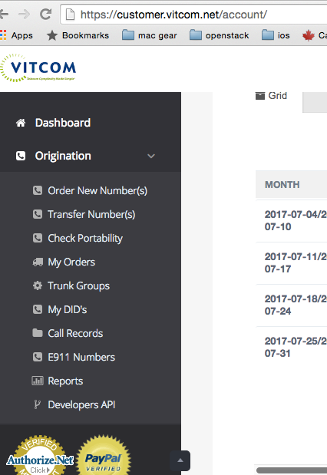
Needed Features
Dashboard
Order New Number
Transfer Number
My Orders
Call Records
Reports
Billing
Payments
Billing Activity
Payment History
Invoices

Slide 15
Payment
Need to be able to auto generate new invoices for monthly plan DIDs
Need to be able to auto credit money from paypal ( paypal has api for that )
Need to send out disconnection notice if the month plan is not paid before expired and auto email to vendor to discontinue the DID

